Slide 1











Euler:
$$s_{i}$$
$$s_{i+1}$$
$$v_{i}$$
$$v_{i+1}$$
$$a_{i}$$
Verlet:
$$s_{i−1}$$
$$s_{i}$$
$$s_{i+1}$$
$$a_{i}$$
Frame $i−1$
Frame $i$
Frame $i+1$

Slide 2
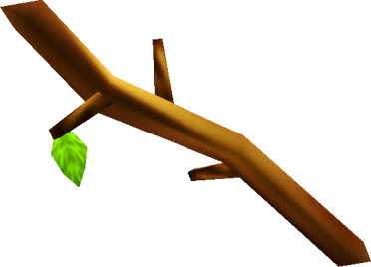













$${\vec{p}}_{0}$$
$${\vec{p}}_{1}$$
fLen
$${\vec{p}}_{0}$$
$$\vec{v}$$
$${\vec{p}}_{1}$$
m_vP0
m_vP1
$$\left\|\vec{v}\right\|$$
LEN
$${\vec{p}}_{0}$$
$${\vec{s}}_{0}$$
$${\vec{s}}_{1}$$
$${\vec{p}}_{1}$$
$$−c\vec{v}/2$$
$$d$$
$$c\vec{v}/2$$

Slide 3








$${\vec{p}}_{2}$$
$${\vec{p}}_{2}$$
$${\vec{p}}_{0}$$
$${\vec{p}}_{0}$$
$${\vec{p}}_{1}$$
$${\vec{p}}_{1}$$
$${\vec{p}}_{1}$$
$${\vec{p}}_{1}$$

Slide 4
m_vP1
m_vP1

Slide 5
CObjectManager
CSpring
m_stdPt
m_pV0
CPoint
m_pV1
CPoint
m_stdSpr

Slide 6
CBody
CSpring
m_stdPt
m_pV0
CPoint
m_pV1
CPoint
m_stdSpr

Slide 7
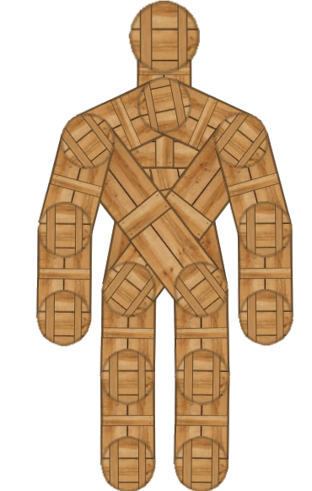
HEAD_PT
STERNUM_PT
LSHLDR_PT
RSHLDR_PT
LELBOW_PT
RELBOW_PT
LHIP_PT
RHIP_PT
LHAND_PT
RHAND_PT
LKNEE_PT
RKNEE_PT
LFOOT_PT
RFOOT_PT

